Slide 1

Dead
History
Tours
Ghosts of Cholera
Notes:
Hello, my name’s Emily Cook, and I’m here to present on ways your cemetery data can be turned into more ghost tours and marketing materials. Today, I’m coming to you as a Ghost of Cholera as part of Nashville City Cemetery’s Dead History Tours: Where Nashville’s Past Comes to Life.

Slide 2
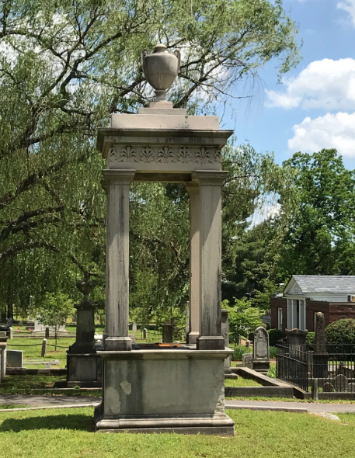
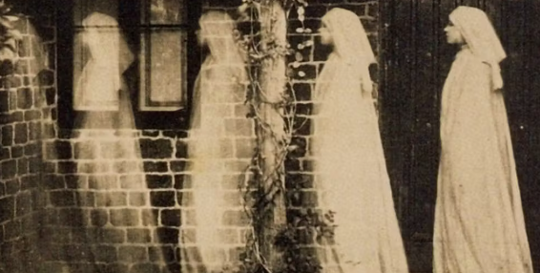
Dead History Tours
Leveraging Data for Public History
You know this cemetery is important. Founded in 1822, it’s the oldest in Nashville with over 19,000 burials!
How can we use the data to help build tours that help the public connect with history and donate to your organization?
What can the cemetery teach the public about the relationships between land, weather, inequality, and disease?
Notes:
Nashville’s oldest cemetery is full of data. This data provides you with tools you can use to help bring the past to your visitors and tell stories about how disease, weather, inequality, and the landscape itself all impact the human experience. While cholera and TB might be in the past, the relationships between weather, inequality, and disease are very much alive today.

Slide 3
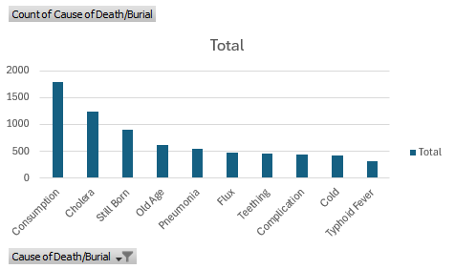
Top 10 Causes of Death
Consumption (TB)
Cholera
Still born
Old Age
Pneumonia
Flux
Complication
Cold
Teething
Typhoid
Notes:
Speaking of cholera and TB, here are your top causes of death. Some of these diseases are relatively to foreign to Nashville residents and visitors today, which make them interesting and thought-provoking tour materials.

Slide 4
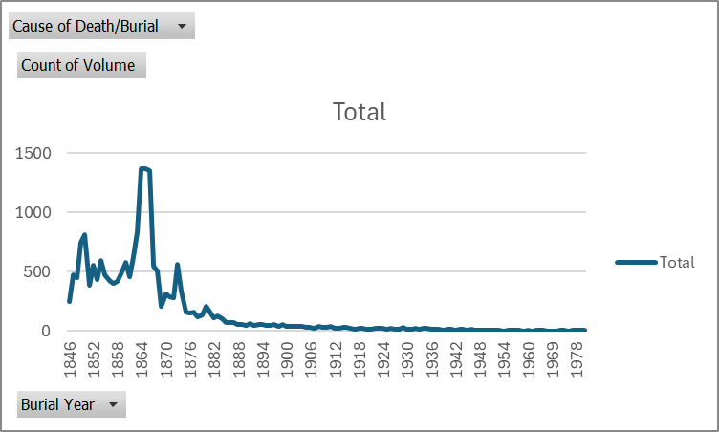
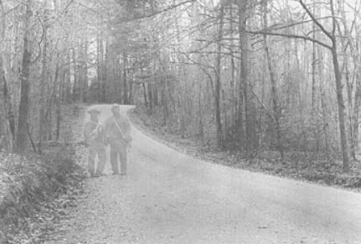
A Window on History
Cholera Epidemics
More later!
Civil War Deaths
In particular, the Battle of Nashville (Dec 15-16, 1864), which resulted in over 9,000 casualties overall. The number of burials after this battle trickled into the cemetery.
Yellow Fever
1873-1878.
Notes:
Showing your guests the story of death over time helps them put past epidemics and past lives in context. Here, we can clearly see cholera, Civil War deaths, and Yellow fever coming through loudly from the past.

Slide 5
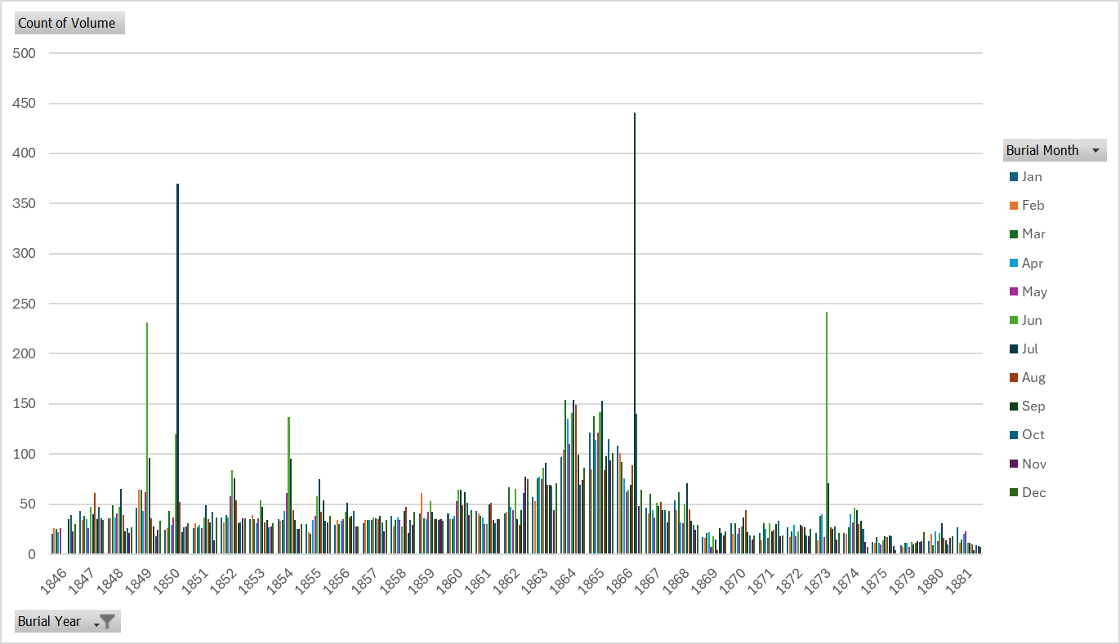
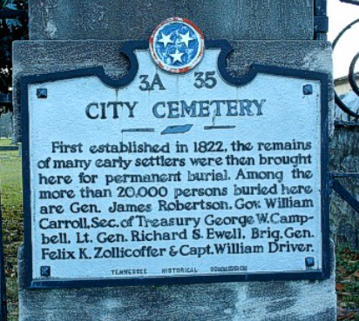
Old Diseases,
Same Landscapes
Notes:
Diseases also fluctuated throughout the months. It would be interesting if these spikes in June were related to a specific disease…wouldn’t it? And many spikes in May-June seem to relate to the cholera spikes…let’s look deeper.

Slide 6
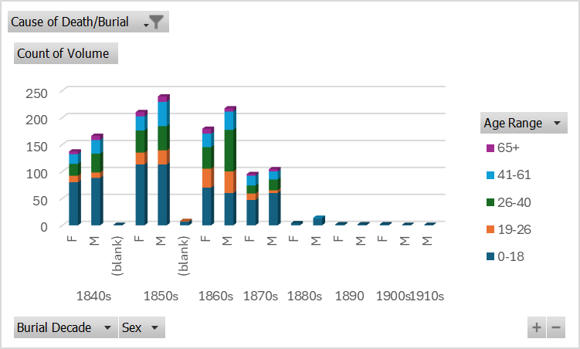
Cholera Outbreaks
The 1850s
This was part of an epidemic from 1849 to 1860, which killed President James Polk.
Summer of 1866
A second outbreak hit Nashville, killing over 800 people in six weeks. Almost half of the deceased were buried here.
1873
In 1873, cholera followed the railroad. An outbreak occurred in New Orleans and traveled from there to Memphis, where imprisoned railway workers brought it to Nashville.
Notes:
Here’s what the cholera outbreaks looked like zoomed out. Cholera came for male and female alike, with some disparities we’ll get into later. As you can see, cholera disproportionately impacted those under the age of 18.

Slide 7
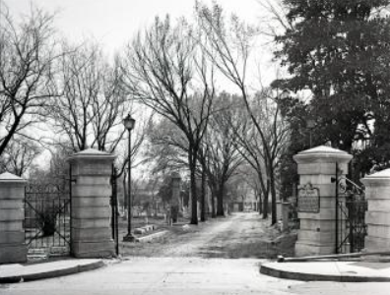
Dead History Tours: Cholera
Cholera
Understanding Disease in Context
Woes and Weather
Bacterial infection
Most commonly spread through contaminated water
May & June historically rainiest months in Nashville
Changes in rainfall mean changes in cholera
Cemetery data reveals links with disease context that tour participants probably would never get in a history book.
What does the past teach us about the connections between weather, inequality, health?
Notes:
Cholera is both an awful way to die as well as part of the living landscape. A bacterial infection that wreaks havoc on the gut, it’s a primarily waterborne illness.

Slide 8
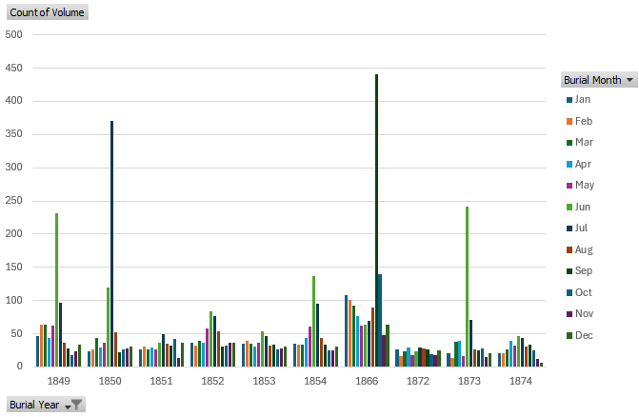
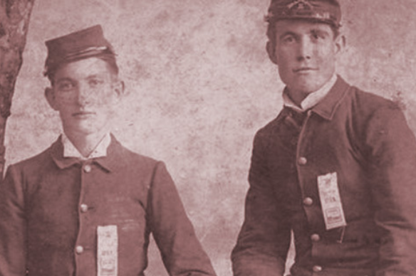
Cholera and Rainy Months
Notes:
Here, we can see that cholera surged in months after high rainfall. The 1873 outbreak in particular spread up from New Orleans amongst railway workers, following rail and rain into Nashville. Fisk University Opened September 1866. Outbreak caused by the city’s poor waste management systems, which disportionately impacted black communities.

Slide 9
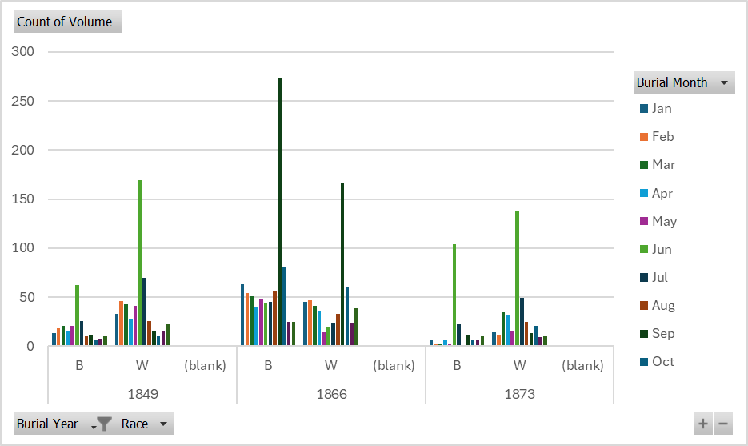
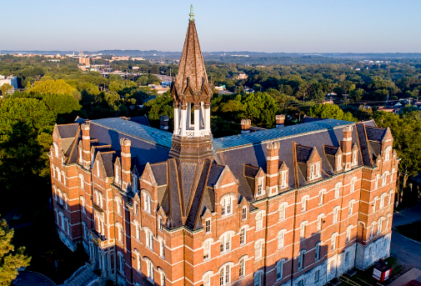
Inequality in Waste Management Impacts Fisk University
Notes:
Sadly, cholera deeply affected Fisk University in its first year of operation in 1866, betraying systemic inequalities in waste management in Nashville that hit black and immigrant communities the hardest. Fisk University is Nashville’s first black university. Fortunately, Fisk survived the epidemic and still stands today.

Slide 10
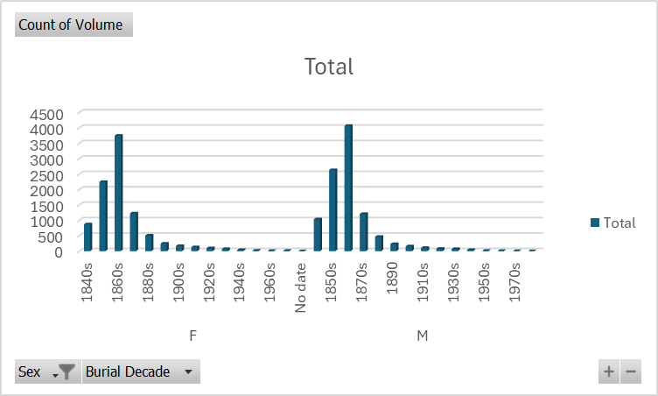
Cholera Deaths by Gender
Notes:
As we saw earlier, cholera impacted genders roughly equally and in a way that’s proportional to gender death counts regardless of cause of death. But we can see that the surge with the opening of Fisk University disproportionately impacted men in the 1860s.

Slide 11
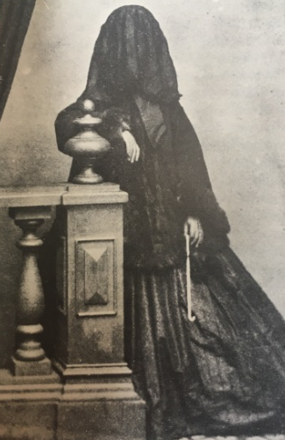
Bring the past to life with Dead History Tours.
Notes:
Future directions: see how the outbreaks affected folks of lower income, farm laborers, and black communities, especially before and after slavery.

